Slide 1
Welcome to the Science Lab!
I am Mrs. Shaw

Slide 2
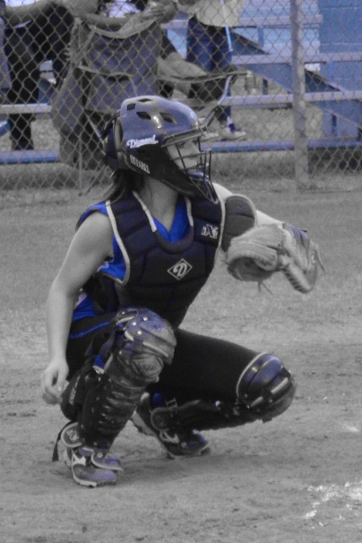
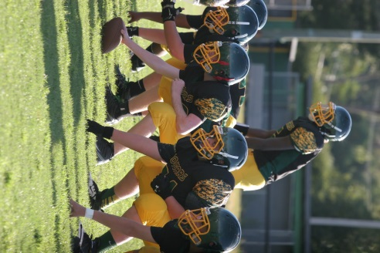
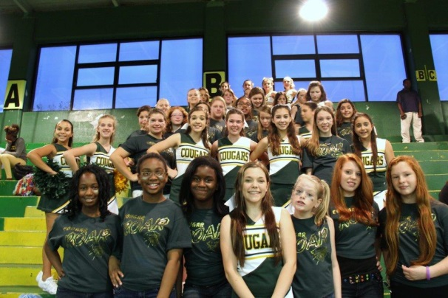
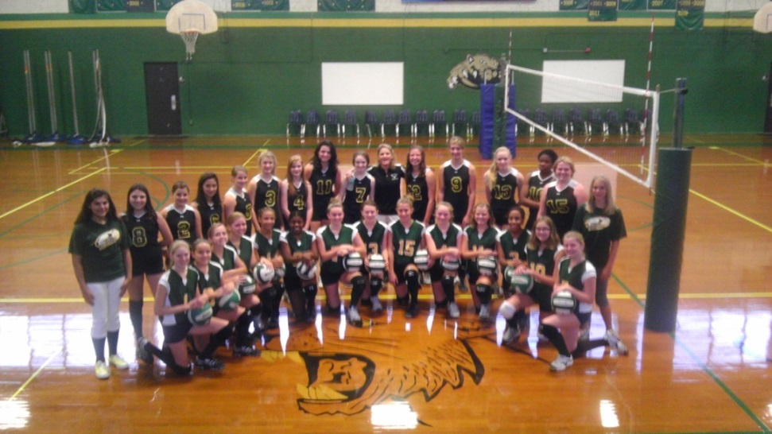
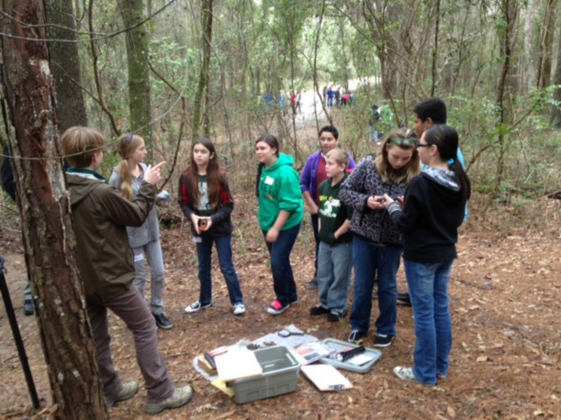
A little about me…….
This is my 6th year at GCJ
I was a student here a long time
ago!
I take a lot of pictures! Some of
them may go in the yearbook ☺

Slide 3
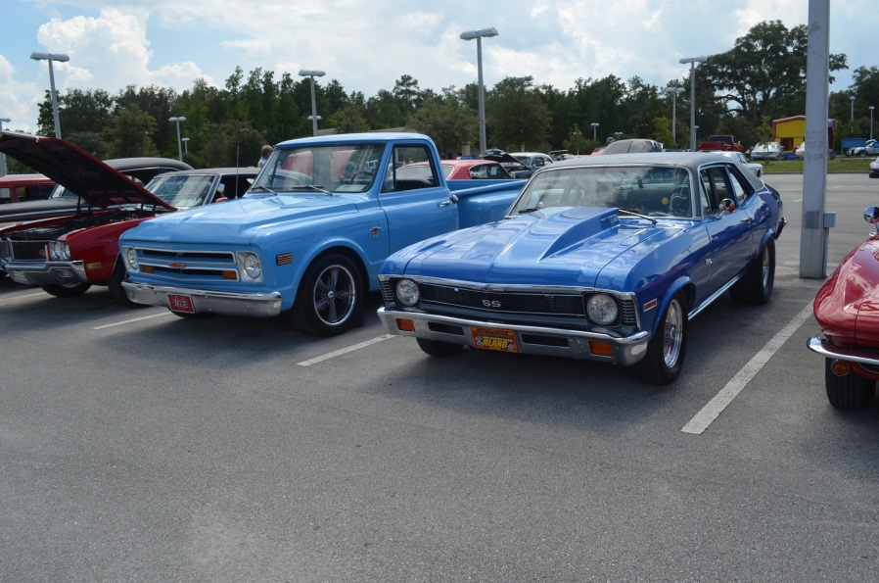
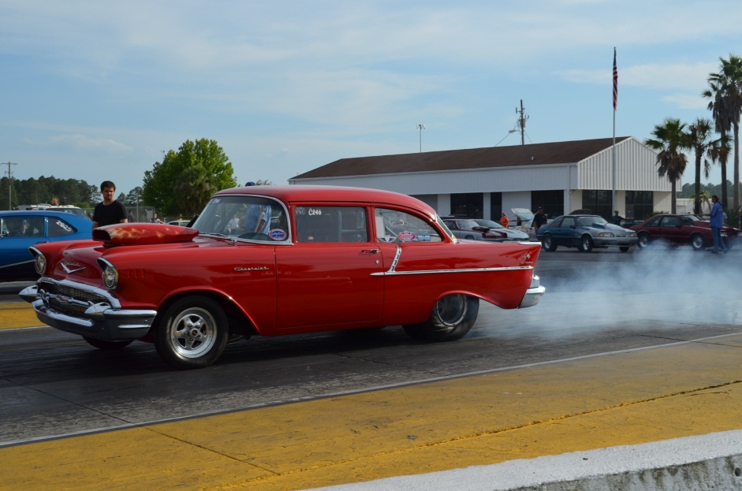
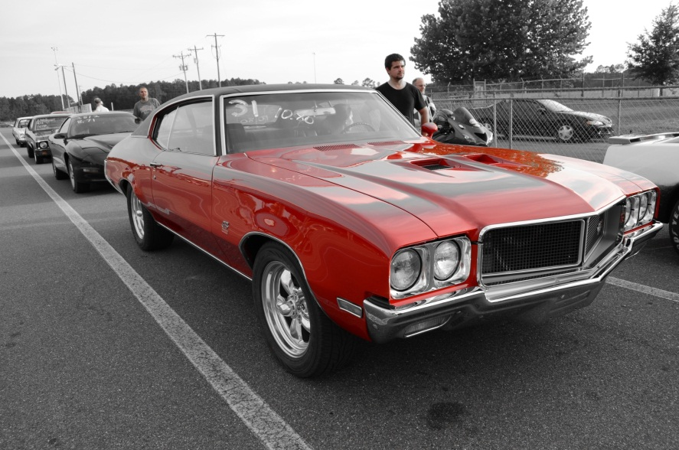
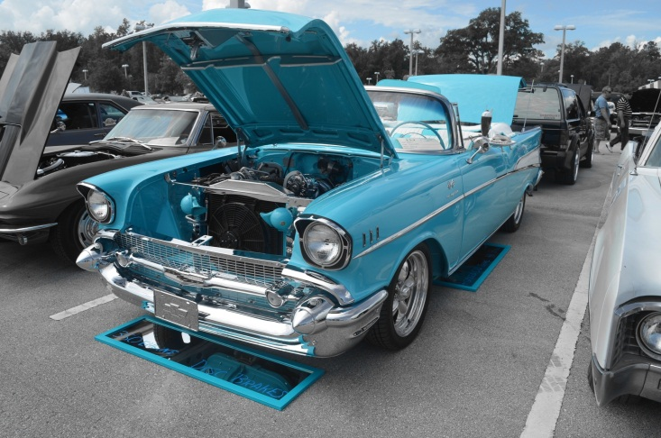
About me……
I like to restore old
cars and go drag racing
So I may talk about cars
some

Slide 4
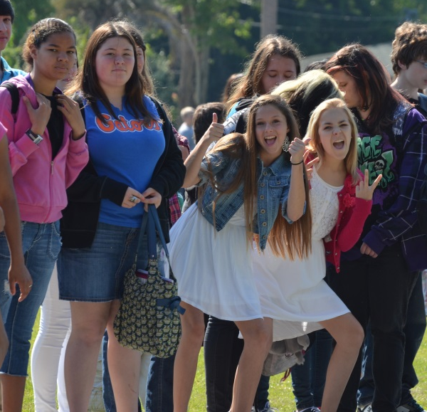
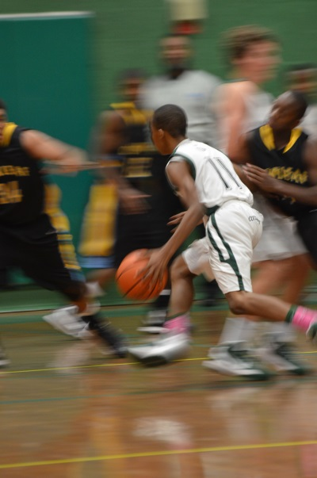
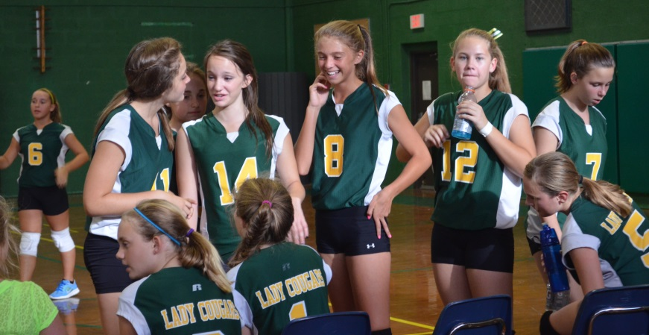
Science is FUN!!!
I want you to enjoy coming to the lab!
The more you put into the class, the more you will get out of it!

Slide 5
Lab Safety
Take Notes!!!
You will be quizzed on the rules

Slide 6
Behavior
You are expected to behave appropriately in all science laboratories at all times.
Absolutely NO horseplay, goofing off, pranks or any disruptive behavior!
Any behavior that is inappropriate for the lab will be written up and you will not be allowed to participate.
You may also lose all of your lab privileges for the year.

Slide 7
Experiments
You are only allowed to begin an experiment AFTER the teacher gives directions to do so.
You MUST read ALL of the procedures before beginning your experiment.
You may NOT do any experiments other than what the teacher has assigned.
Follow directions at all times!

Slide 8
Lab Equipment
You may not remove anything from the lab.
Make sure you care for the lab equipment and materials appropriately.
Do not carry lab materials around the room.
You must always use two hands when moving any of the equipment.
Never leave your experiment unattended
It is expensive and we can’t replace it easily, so take care of it!

Slide 9
Food in Lab?
Absolutely NONE!!!
No gum, no food, drinks, candy etc.!
You may not eat anything that is a part of the lab, even if it is a food substance!
Treat all substances as if they are hazardous!
Don’t put anything from the lab near your face!
If you bring your lunch to school, leave it with your book bag in the closet.
This is very important!

Slide 10
Clothing
Don’t wear your favorite outfit on lab day
Anyone with long hair must have it tied back
No dangly jewelry (long necklaces, earrings, or bracelets)
You must wear goggles any time we use:
chemicals, heat, or glassware
We will wear aprons to protect our clothes
You must wear CLOSED toe shoes!!!

Slide 11
Accidents
Report any accidents IMMEDIATELY!
This includes:
Injuries
Spills
Broken equipment
Broken glass
Fire- grab the extinguisher

Slide 12
Accidents
If you break something that is glass, do NOT pick it up with your bare hands! Let a teacher know and we will help clean it up
Do not be afraid to tell us something has happened! We have to know so we can make sure no one gets hurt!

Slide 13
Know where the following items are Located in the room:
fire blanket
fire extinguisher
exits
eyewash station
emergency shower
waste disposal container
fume hood

Slide 14
Procedures
Leave your book bags in the closet on the shelf to the left when you enter the class
Make sure you have your journal and something to write with
Put on lab gear that will be required for that day (goggles, aprons, hair up, closed toe shoes)
Sit at a desk and begin reading directions until you are told to begin

Slide 15
Procedures
Follow ALL directions carefully!
If you are not sure what to do, ask! Do not guess and move on
Be respectful to others and the materials
You must clean up your area before you leave
HAVE FUN!!! Learning is fun! Engage in what you are doing and you will enjoy the class ☺

Slide 16
Quiz!
Take out a sheet of paper
In each picture, list what safety infraction stands out to you most
Do not use the same answer twice

Slide 17
#1

Slide 18
#2

Slide 19
#3

Slide 20
#4

Slide 21
#5

Slide 22
#6

Slide 23
#7

Slide 24
#8
List at least 3 lab safety infractions(violations) that you see in the video
http://www.teachertube.com/video/lab-safety-gone-wrong-200320

Slide 25
Answers
All slides can have multiple answers, these are the most common or obvious
1. No goggles, food in the lab, no gloves, no aprons
2. Hair not tied back, no aprons, no goggles, bags on the table
3. No paying attention to lab, fire on the table not putting it out (fire extinguisher)
4. Don’t drink/eat lab supplies
5. No horseplay, goggles, not in lab station

Slide 26
Answers
6. No open toe shoes, don’t pick up broken glass with your bare hands
7. Don’t pick up broken glass with your bare hands
8-10. These could almost anything as long as they did not list it in 1-7

